Slide 1
Analog to Digital Conversion

Slide 2
Analog to Digital Conversion (ADC):
Analog to Digital Conversion is the process of transforming a continuously varying analog signal (such as sound, light, or temperature) into a discrete digital signal represented by binary numbers, so that it can be processed by computers and digital devices.
This process is carried out by an Analog-to-Digital Converter (ADC)

Slide 3
Pulse Code Modulation (PCM)
The most common technique used to change an analog signal to digital data (digitization) is called pulse code modulation (PCM). A PCM encoder has three processes
Sampling:.
Quantization:.
Encoding: Representing these quantized levels as binary numbers.

Slide 4
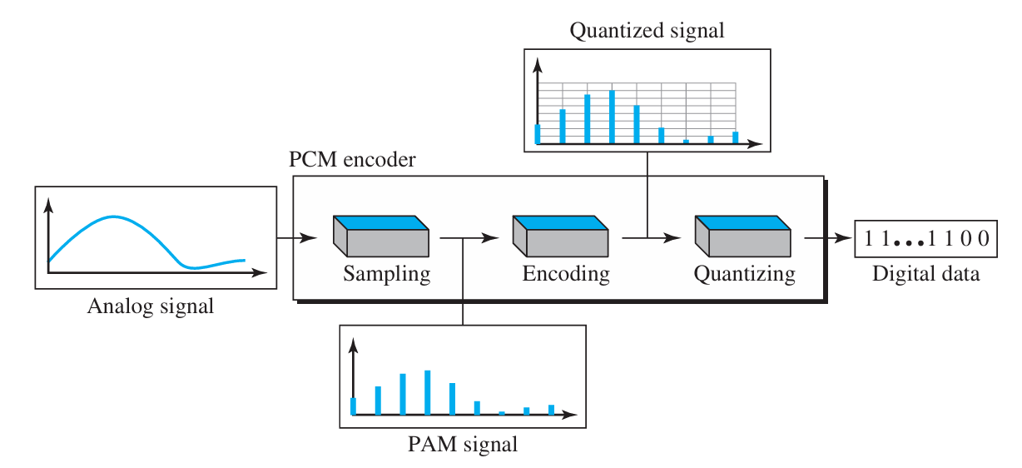
Cont..

Slide 5
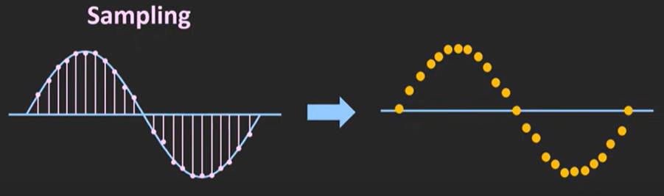
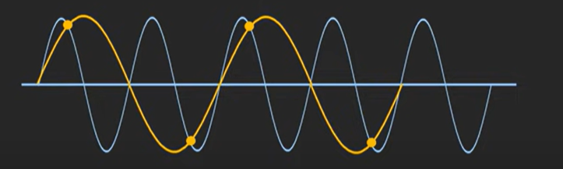
Sampling
Analog sampling is converting a continuous signal into a discrete digital signal by taking regular “snapshots” of its amplitude using an ADC. The sampling rate must be at least twice the highest signal frequency to avoid aliasing (Nyquist-Shannon theorem).
Because the more sample we take the more it will be accurate.

Slide 6
Common sampling rates in music/audio:
8 kHz (8000 samples/sec) → Telephone quality (voice only, narrow band).
22.05 kHz (22050 samples/sec) → Low-quality audio, sometimes used for compressed formats.
44.1 kHz (44100 samples/sec) → CD quality audio (most music is recorded at this rate).
48 kHz (48000 samples/sec) → Standard for professional video and audio production

Slide 7
Quantization
Quantization is the process of rounding each sample of an analog signal to the nearest fixed level.
turning continuous values into a set of discrete ones. Each level gets a unique binary code, making the signal ready for digital use—like storage, processing, or transmission.

Slide 8
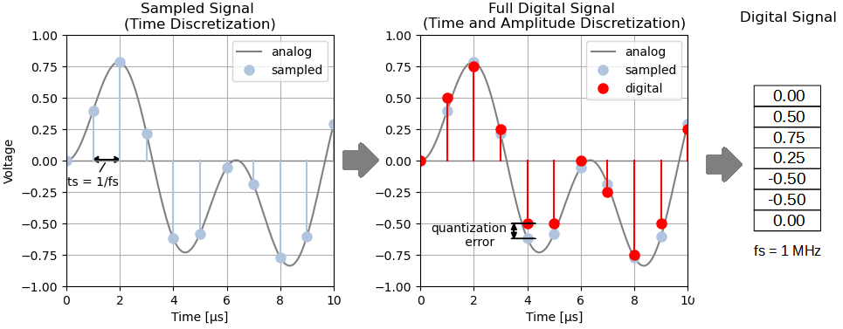
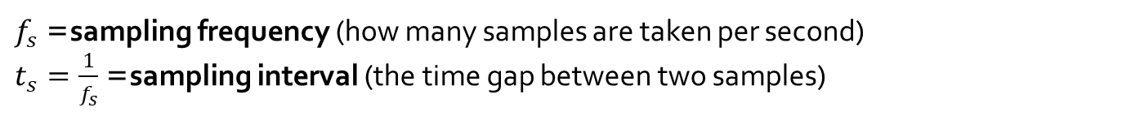
Cont..
$f_{s}$= sampling frequency (how many samples are taken per second)
$t_{s}=\frac{1}{f_{s}}$= sampling interval (the time gap between two samples)

